Slide 1




Parking Assistant using OpenCV
This Photo by Unknown Author is licensed under CC BY-SA

Slide 2



Contents
About the Project
Libraries Used
Project Pipeline
Screenshots
Highlights
Sources

Slide 3
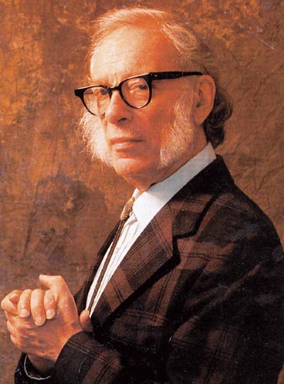
“Life is a Journey, but don’t worry, you’ll find a Parking Slot at the end.”
Isaac Asimov

Slide 4




About the Project
My project is Parking Assistant using OpenCV which helps in detecting the Parking Slots when required as per user’s request. It is highly accurate and sends a instant notification to the user which uses Twilio to send the message (DM) instantly.

Slide 5
Libraries Required/Used
Library Name | Use Case
os | The OS module in Python provides functions for creating and removing a directory (folder), fetching its contents, changing and identifying the current directory, etc.
numpy | Used for doing mathematical calculations which the math module can’t do.
cv2 | OpenCV is the huge open-source library for the computer vision, machine learning, and image processing and now it plays a major role in real-time operation
mrcnn | Most used for image segmentation. The model can return both the bounding box and a mask for each detected object in an image
twilio | Module to send instant message or WhatsApp notification to the user.

Slide 6



Watch like a Hawk from Now!!!

Slide 7
Project Pipeline
Camera
Input from Webcam Stream
Dataset
Build a Model (here used a pretrained model)
Process the Webcam Stream as per the needs (focus only the cars)
Detection
Final
Send Notification to the User using Twilio
Now sense the car’s position and detect the movement when the parking slot becomes free
Machine Learning

Slide 8
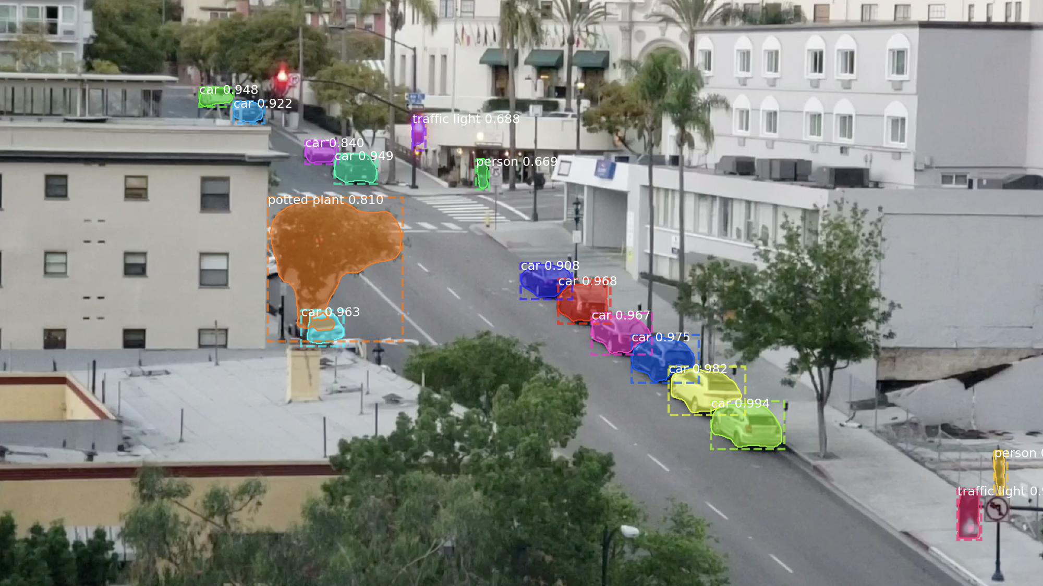
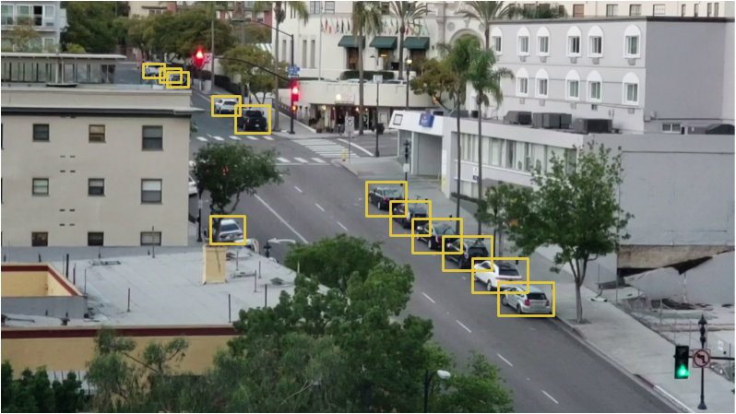
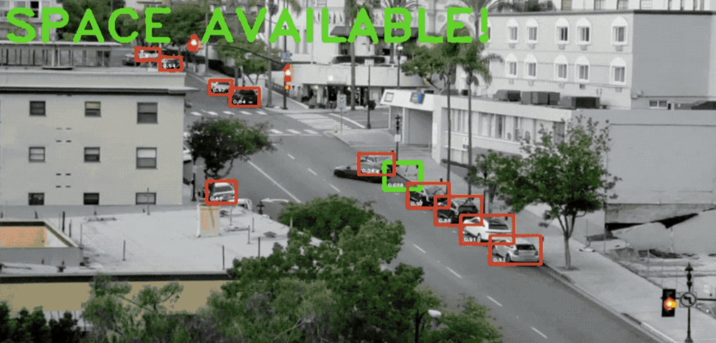
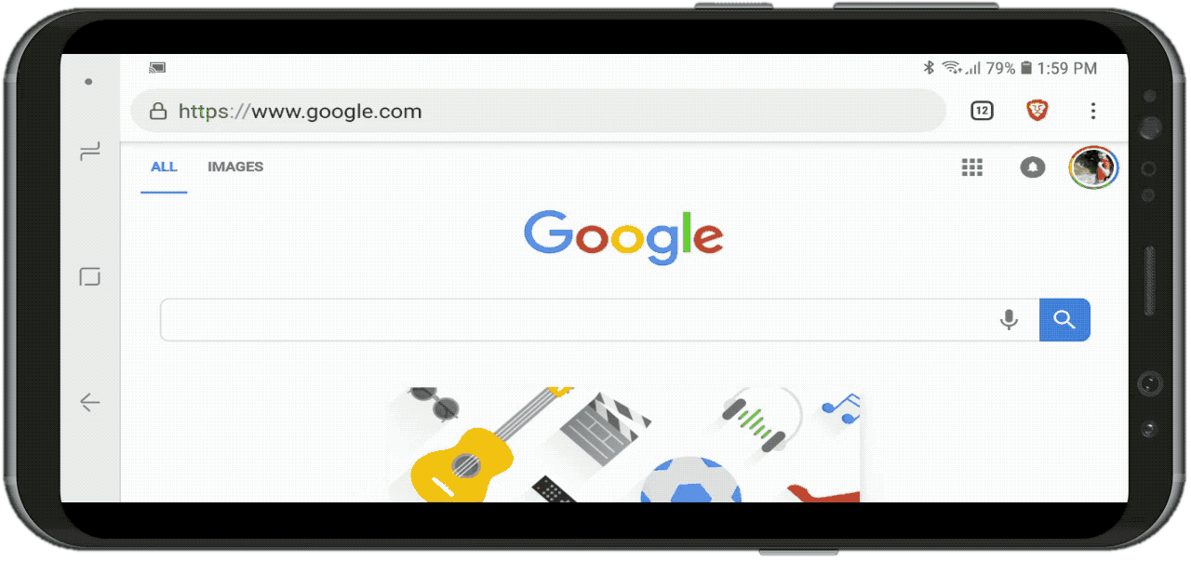

Screenshots
Stage: 1
Stage: 2
Stage: 3
Stage: 4
Detecting objects using MaskRCNN
Finding only the Cars and box them
Detect the motion and find slot
Send Instant notification to user with Twilio

Slide 9

Sources
https://www.analyticsvidhya.com/blog/2019/07/computer-vision-implementing-mask-r-cnn-image-segmentation/
https://docs.opencv.org/4.5.2/d6/d00/tutorial_py_root.html
https://www.twilio.com/docs/sms/quickstart/python

Slide 10


Thank You & Happy Hacking!!!
By
Name: Sriniketh J
College: PSG Institute of Technology and Applied Research
Department: Electronics and Communication Engineering
Year of Study: 2nd Year
E-Mail: d20l213@psgitech.ac.in

